Slide 1
Analytical and Machine Learning based Frameworks for Synthesis of Planar, Spherical and Spatial Mechanisms
By
Shashank Sharma

Slide 2
Outline
Background and Motivation
Spatial Alt-Burmester Synthesis
Unified Motion Synthesis
Planar Alt-Burmester Synthesis
Planar Path Synthesis
Unified Simulation
Summary

Slide 3
Background and Motivation

Slide 4
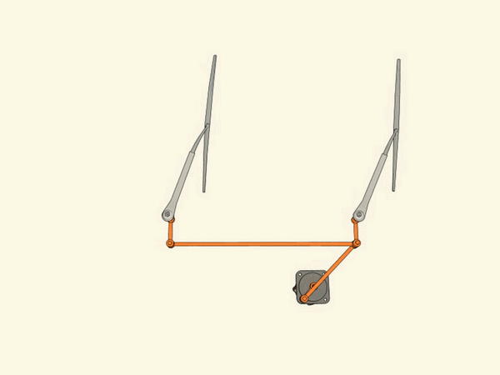
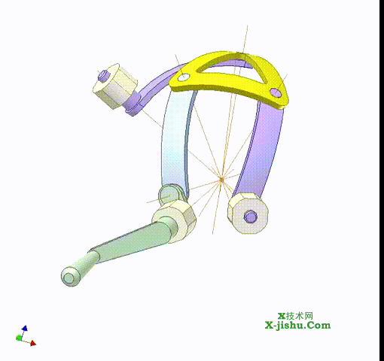
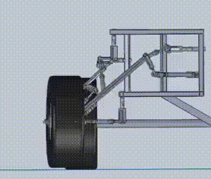
What are Mechanisms?
A mechanism is a network of rigid links and joints with one link fixed.
Planar mechanism
Spherical mechanism
Spatial Platform

Slide 5
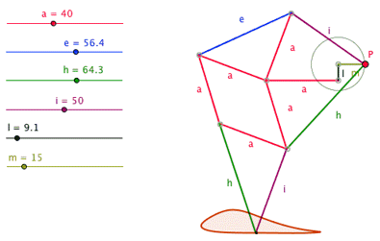
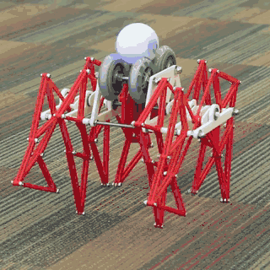
Mechanism Design
Mechanism design involves finding a mechanism which carries out a user specified task.
The process involves selection of joint types and link dimensions.
Example – Eight-bar Theo-Jansen linkage enables robotic walking.

Slide 6
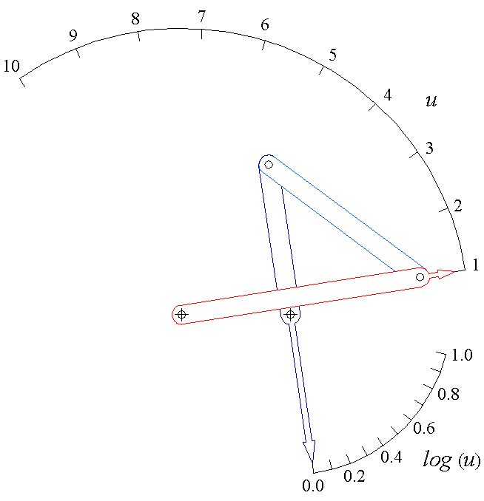
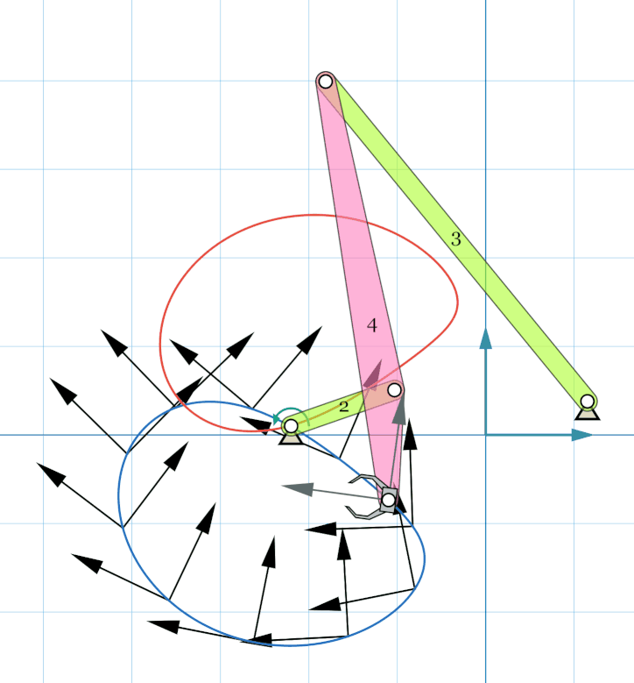
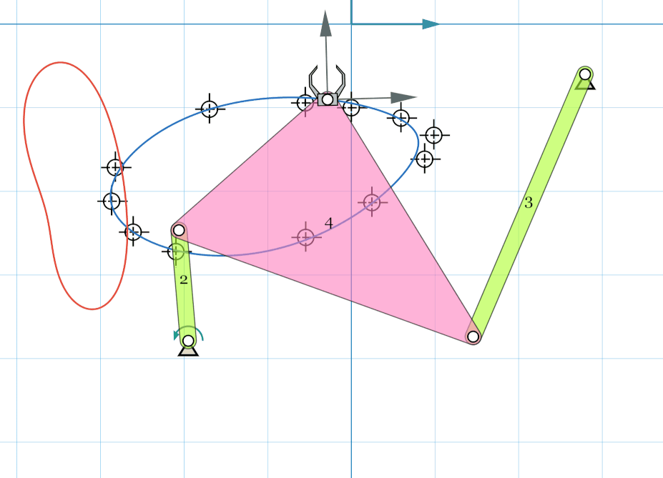
Mechanism Design
Design problems have been conventionally posed as Motion, Path or Function Synthesis problem.
Motion Synthesis
Path Synthesis
Function Synthesis

Slide 7
Problem Statement
Practical problems can include multiple constraints. Algorithms don’t exist for these scenarios.
Most of the research is focused on synthesis of Planar mechanisms.
Unify Path and Motion Synthesis as the Alt-Burmester Synthesis.
Unify Synthesis of Planar, Spherical and Spatial mechanisms.
Mechanism Synthesis Approach
Design Constraints
Poses+ Path points
+ Input-output link relationship
Additional constraints:
Fixed pivot location,
Moving pivot location,
Link lengths, etc.
Solver
Solution mechanism
Motion + Path
Synthesis
Planar + Spherical
+ Spatial Mechanisms

Slide 8
Dissertation Contributions
Alt-Burmester Synthesis
- ML approach for spatial mechanisms
- Analytical approach for planar mechanisms
Kinematic Analysis
- Numerical approach to simulate planar, spherical and spatial mechanisms
Motion Synthesis
- Analytical approach for unified synthesis of planar, spherical, and spatial mechanisms
Path Synthesis
- ML approach for spatial mechanisms
- Analytical approach for planar mechanisms

Slide 9
Conference Publications
Sharma, Shashank, and Purwar, Anurag. “Path Synthesis of Defect-free Spatial 5-SS Mechanisms using Machine Learning”, Proceedings of the ASME 2020 International Design Engineering Technical Conferences and Computers and Information in Engineering Conference, IDETC2020-22731.
Sharma, Shashank, and Purwar, Anurag. “Unified Motion Synthesis of Spatial Seven-bar Platform Mechanisms and Planar Four-bar Mechanisms”, Proceedings of the ASME 2020 International Design Engineering Technical Conferences and Computers and Information in Engineering Conference, IDETC2020-22718.
Sharma, Shashank, and Purwar, Anurag. “Using a Point-Line-Plane Representation for Unified Simulation of Planar and Spherical Mechanisms.” Proceedings of the ASME 2019 International Design Engineering Technical Conferences and Computers and Information in Engineering Conference. Volume5A: 43rd Mechanisms and Robotics Conference. Anaheim, California, USA. August 18–21, 2019. V05AT07A030. ASME. doi: 10.1115/DETC2019-98194
Sharma, Shashank, Purwar, Anurag, and Ge, Q. Jeffrey. “A Motion Synthesis Approach to Solving Alt-Burmester Problems by Exploiting Fourier Descriptor Relationship Between Path and Orientation Data.” Proceedings of the ASME 2018 International Design Engineering Technical Conferences and Computers and Information in Engineering Conference. Volume 5B: 42nd Mechanisms and Robotics Conference. Quebec City, Quebec, Canada. August 26–29,2018. V05BT07A077. ASME. doi: 10.1115/DETC2018-85567
Sharma, Shashank, Purwar, Anurag, and Ge, Q. Jeffrey. “Optimal Non-Uniform Parametrization for Fourier Descriptor Based Path Synthesis of Four Bar Mechanisms.” Proceedings of the ASME 2018 International Design Engineering Technical Conferences and Computers and Information in Engineering Conference. Volume 5A: 42nd Mechanisms and Robotics Conference. Quebec City, Quebec, Canada. August 26–29, 2018. V05AT07A033. ASME. doi: 10.1115/DETC2018-85568

Slide 10
Journal Publications
Sharma S., Purwar A., 2020, “A Machine Learning Approach to Solving the Alt-Burmester Problem for Defect-free Spatial Mechanism Synthesis”, ASME. J. Comput. Inf. Sci. Eng., manuscript under preparation
Sharma S., Purwar A., 2020, “Unified Design of Spatial, Spherical and Planar Mechanisms for the Motion Synthesis Problem”, ASME. J. Mechanisms Robotics. JMR-20-1314, Under Review
Sharma, S., and Purwar, A. (May 26, 2020). “Using a Point-Line-Plane Representation for Unified Simulation of Planar and Spherical Mechanisms.” ASME. J. Comput. Inf. Sci. Eng. December 2020; 20(6): 061002. doi:10.1115/1.4046817
Sharma, S., Purwar, A., and Jeffrey Ge, Q. (December 17, 2018). “A Motion Synthesis Approach to Solving Alt-Burmester Problem by Exploiting Fourier Descriptor Relationship Between Path and Orientation Data.” ASME. J. Mechanisms Robotics. February 2019; 11(1): 011016. doi: 10.1115/1.4042054
Sharma, S., Purwar, A., and Jeffrey Ge, Q. (October 18, 2018). “An Optimal Parametrization Scheme for Path Generation Using Fourier Descriptors for Four-Bar Mechanism Synthesis.” ASME. J. Comput. Inf. Sci. Eng. March 2019; 19(1): 014501. doi: 10.1115/1.4041566

Slide 11
Spatial Alt-Burmester Synthesis
A Machine Learning Approach to Solving the Alt-Burmester Problem for Defect-free Spatial Mechanism Synthesis

Slide 12
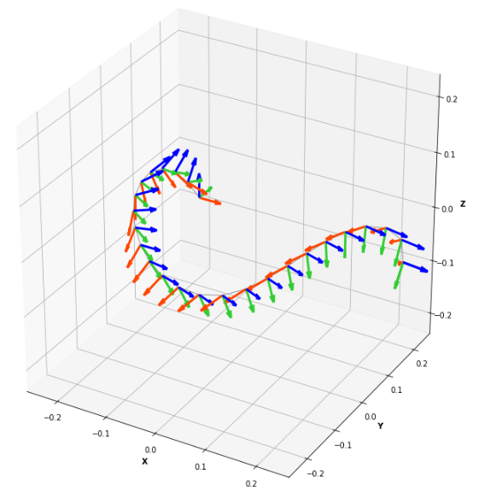
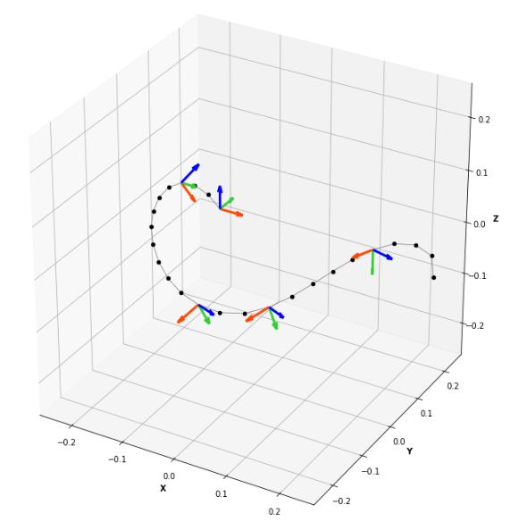
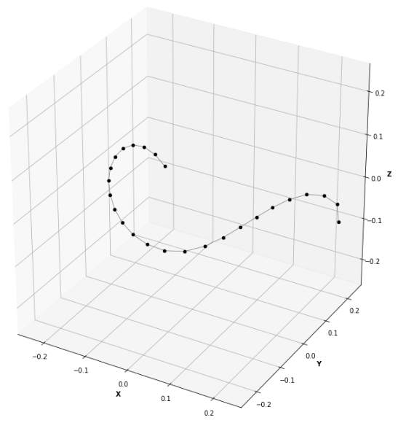
Spatial Alt-Burmester Problem
Motion Synthesis
Alt-Burmester Synthesis
Path Synthesis

Slide 13
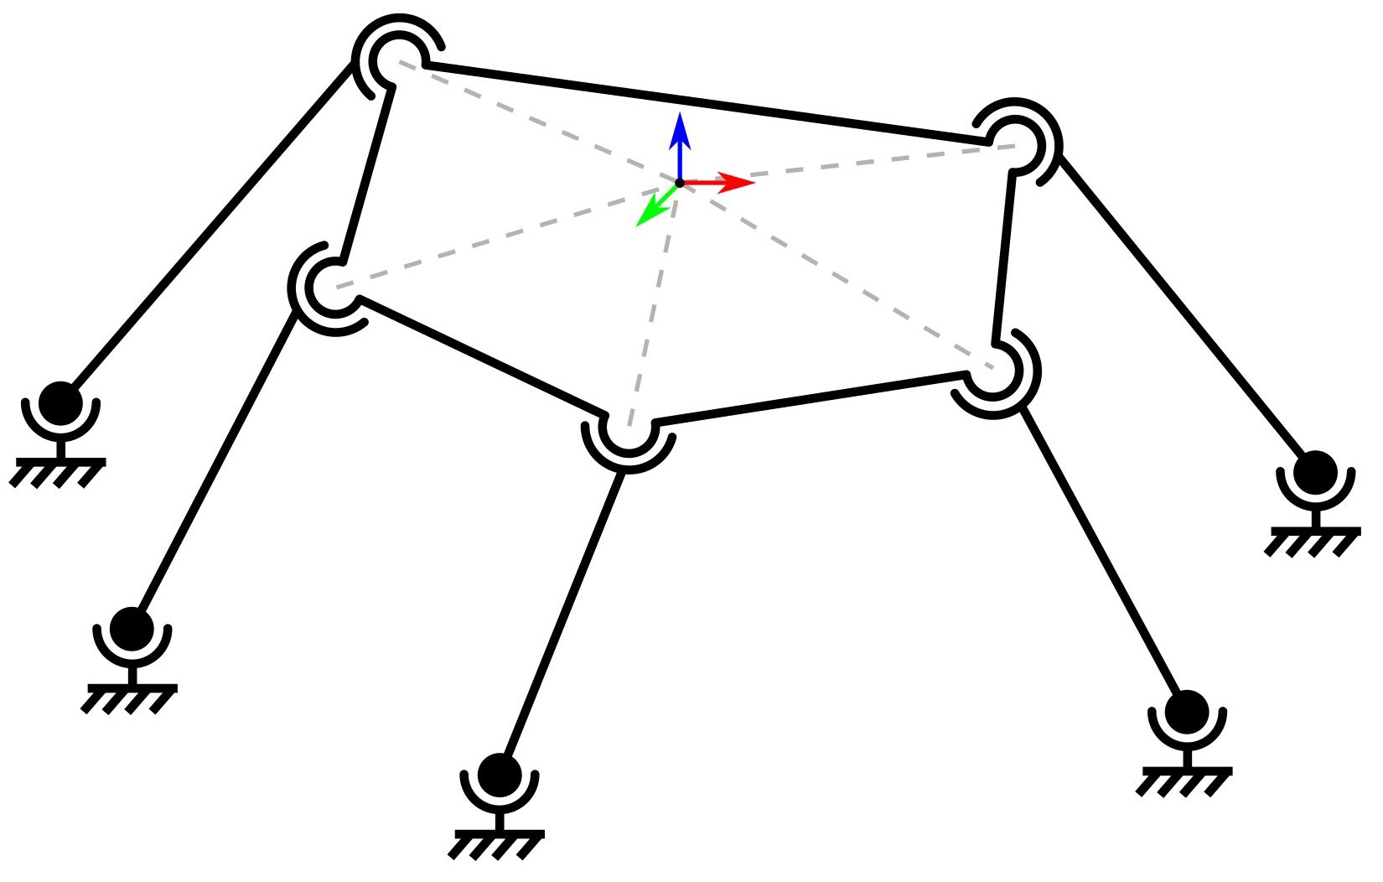
5-SS Mechanism
A 5-SS platform linkage consists of a rigid floating body supported by five legs, each with a spherical joint on both ends.
It is a one degree-of-freedom mechanism.
Spatial 5-SS Mechanism

Slide 14
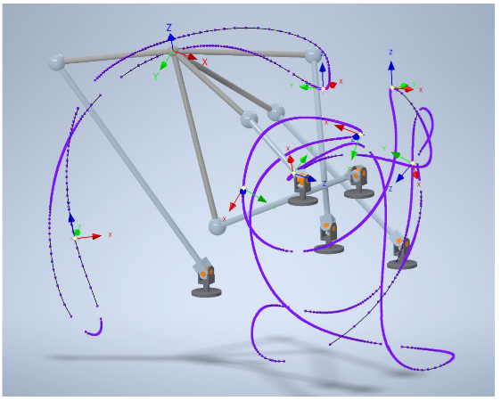
Defect-Free Mechanism Synthesis Problem
Branch Defects
Circuit Defects
Spatial 5-SS mechanism coupler paths tend to have multiple branches and circuits.
Solution concepts need to satisfy input path requirements without defects for it to be useful.
Coupler paths of sample 5SS mechanism

Slide 15
Machine Learning based Algorithm

Slide 16
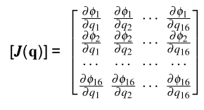
Data Generation using a Kinematic Solver
Constraint for an SS dyad
Iterative solver based on Newton-Raphson method.
Eighteen constraint equations for RR links.
Fifteen MP coordinates and three C coordinates.
A data set of 10,000 defect-free coupler motions is generated.
Each motion consist of 25 path points and orientations
Newton Raphson Iteration
and Jacobian Matrix

Slide 17
Data Preprocessing
Cleanup
Normalization (time, location, orientation, scale)
Balancing
Augmentation
Masking
10,000 Raw Motion Data
417,760 Masked Motion Data

Slide 18
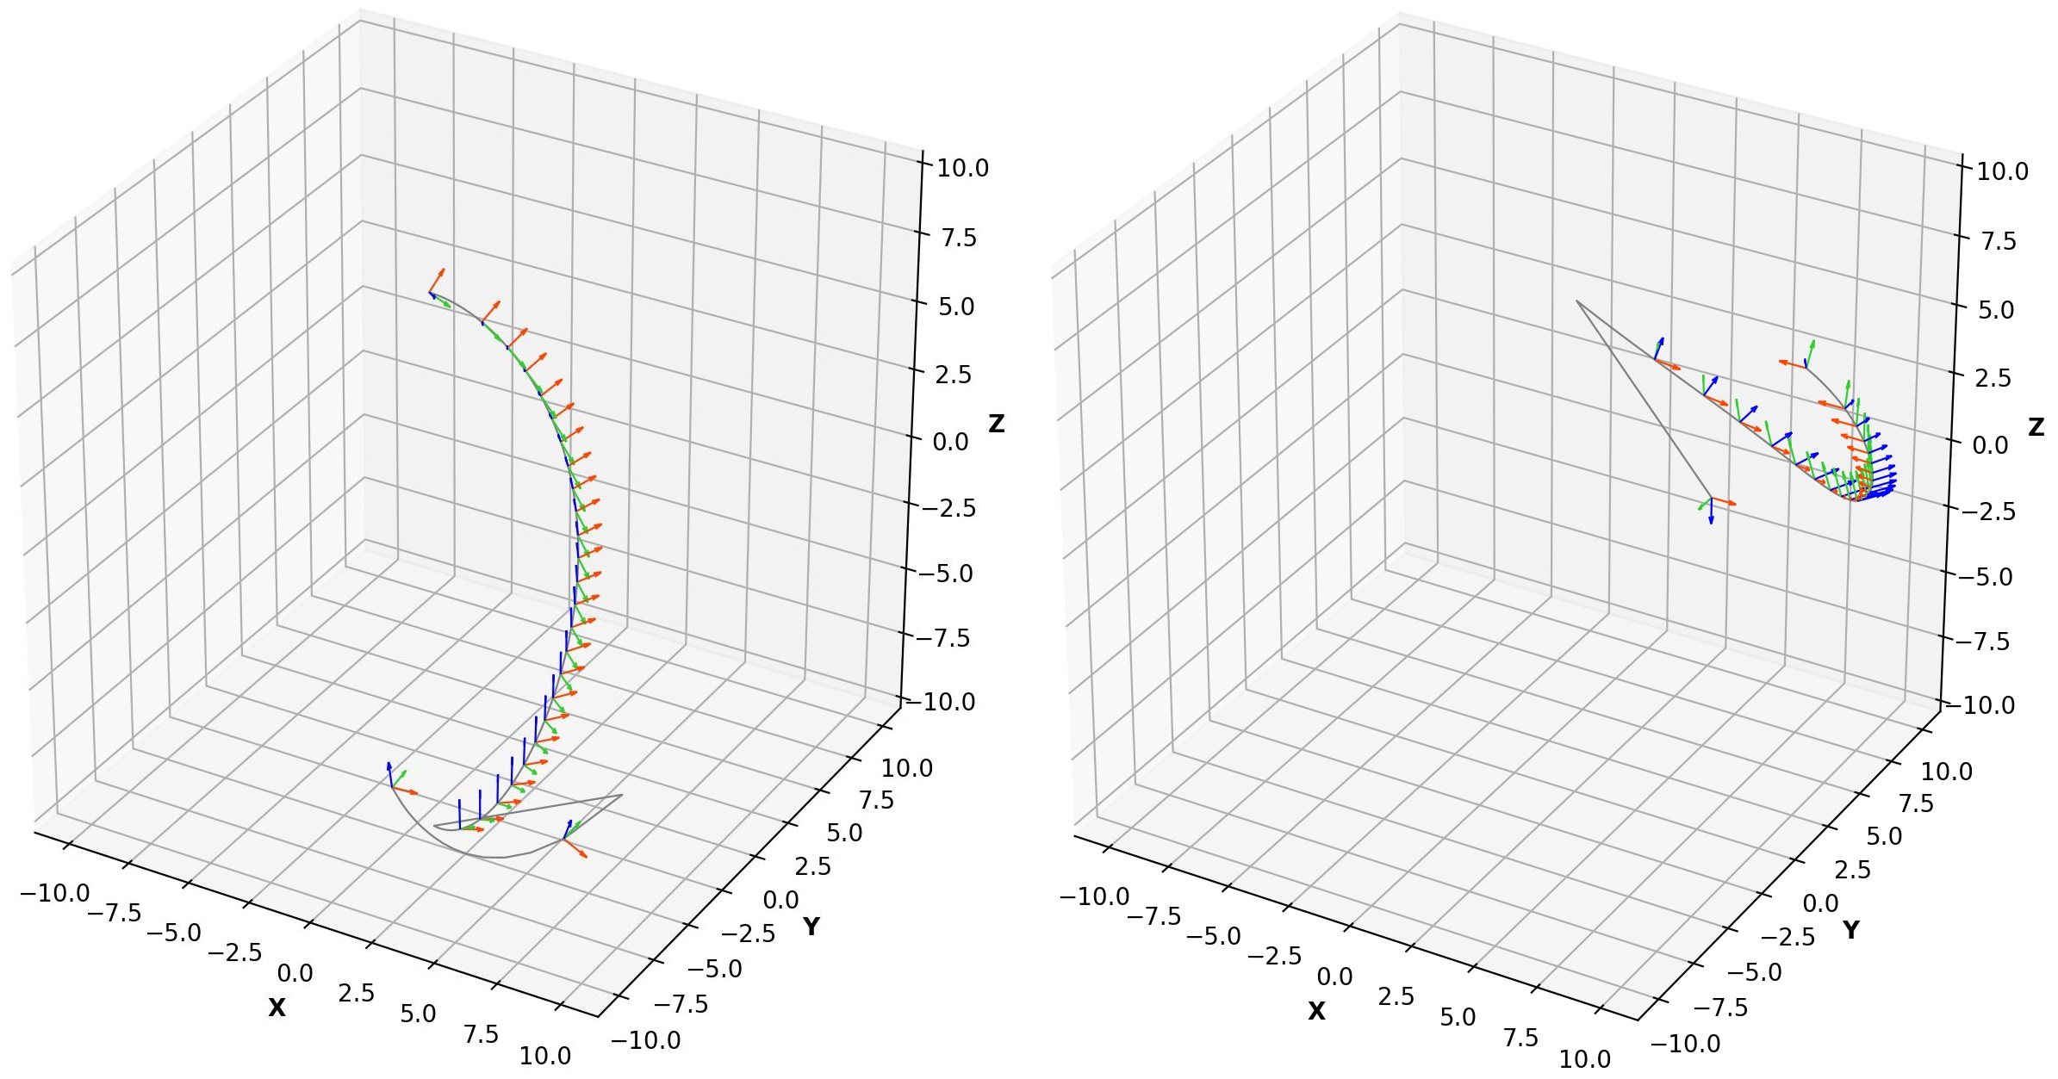
Preprocessing: Cleanup
Solver jumps from one branch to another during simulation.
Motions filtered based on C1 discontinuity in path and orientation.

Slide 19
Preprocessing: Normalizing Time
Arc-length parametrization-based time independent representation.

Slide 20
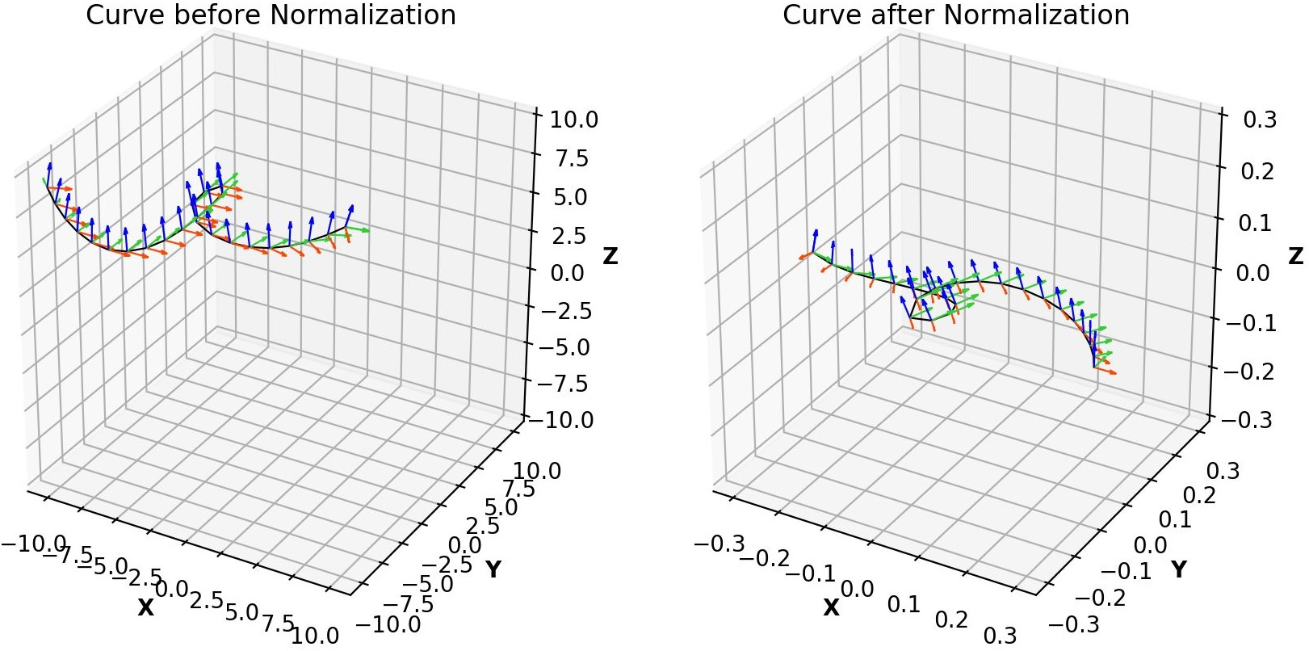
Preprocessing: Normalizing Location, Orientation, Scale & Orientation
Create a representation invariant to rigid transformations.
Mean is translated to origin.
Principal axes are rotated to align with XYZ axes.
Curve scaled to unit length.
Moving frame is aligned with ground frame at the start of motion.

Slide 21
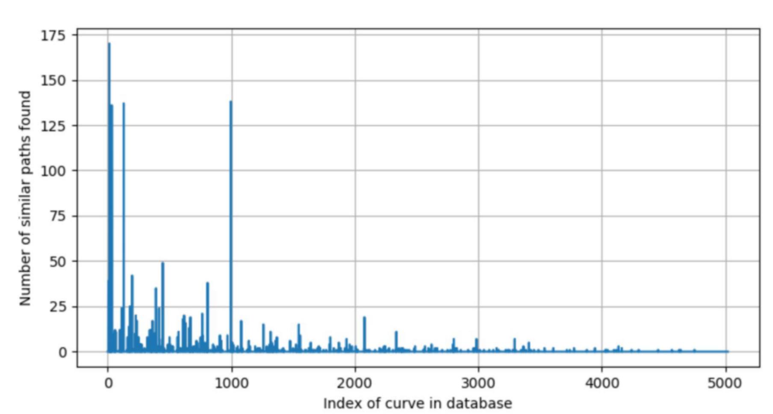
Preprocessing: Data Balancing & Augmentation
Balancing: Minimize bias in the learned model by under sampling common paths.
Similarity score based on path curvature, path torsion and orientations.
Mirroring: Add mirrored curves for the model to learn mirror invariance.
Some common coupler motions
Notes:
Want the model to learn diverse paths.

Slide 22
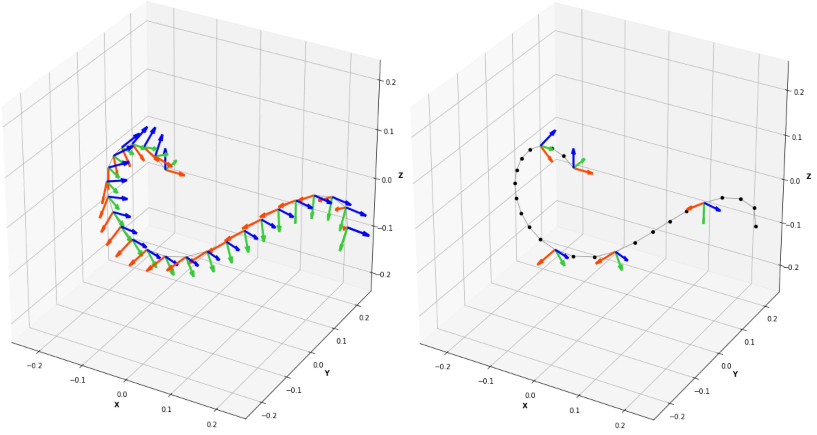
Preprocessing: Data Masking
To learn the underlying relationship between path-points and orientations, some orientations are masked.
Gaussian noise is added for robust learning

Slide 23
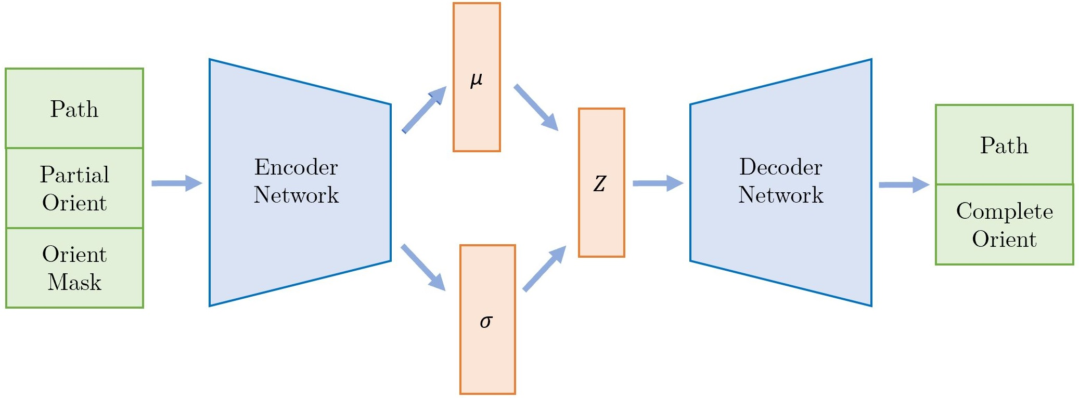
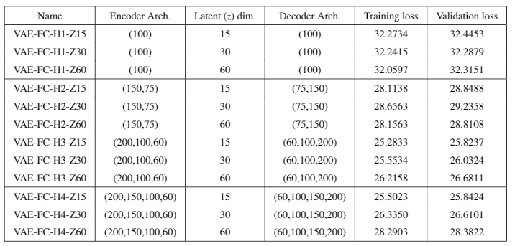
Training and Clustering
Variational Autoencoder is used to learn the underlying relationship between path and orientation data.
RMS and KL-Divergence Losses are used during training
Multiple fully connected VAE architectures were tested.
Latent space signatures of the complete database are generated and clustered using K-Means Clustering.

Slide 24
Inference example
Use the trained model and clustered database to generate a variety of mechanisms.

Slide 25
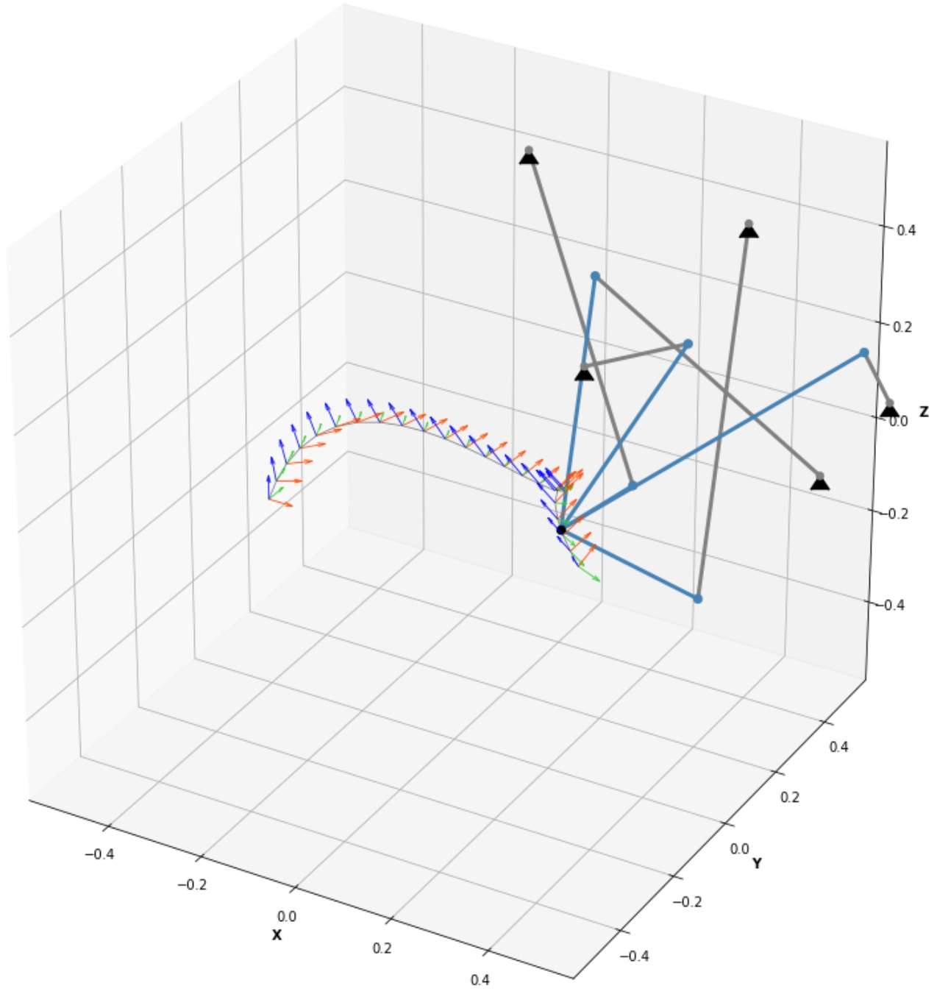
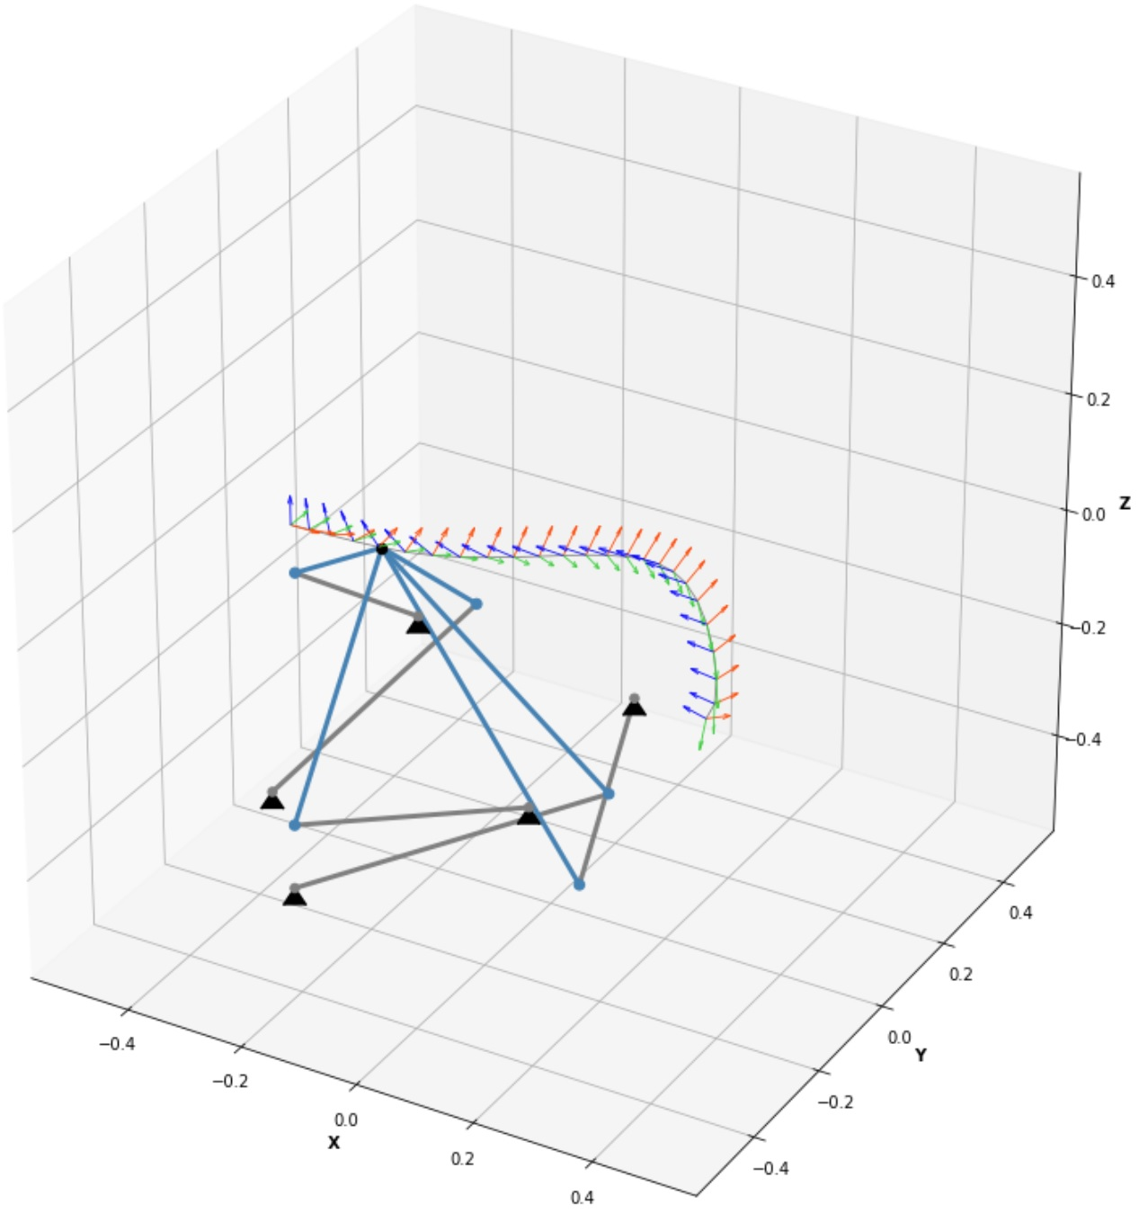
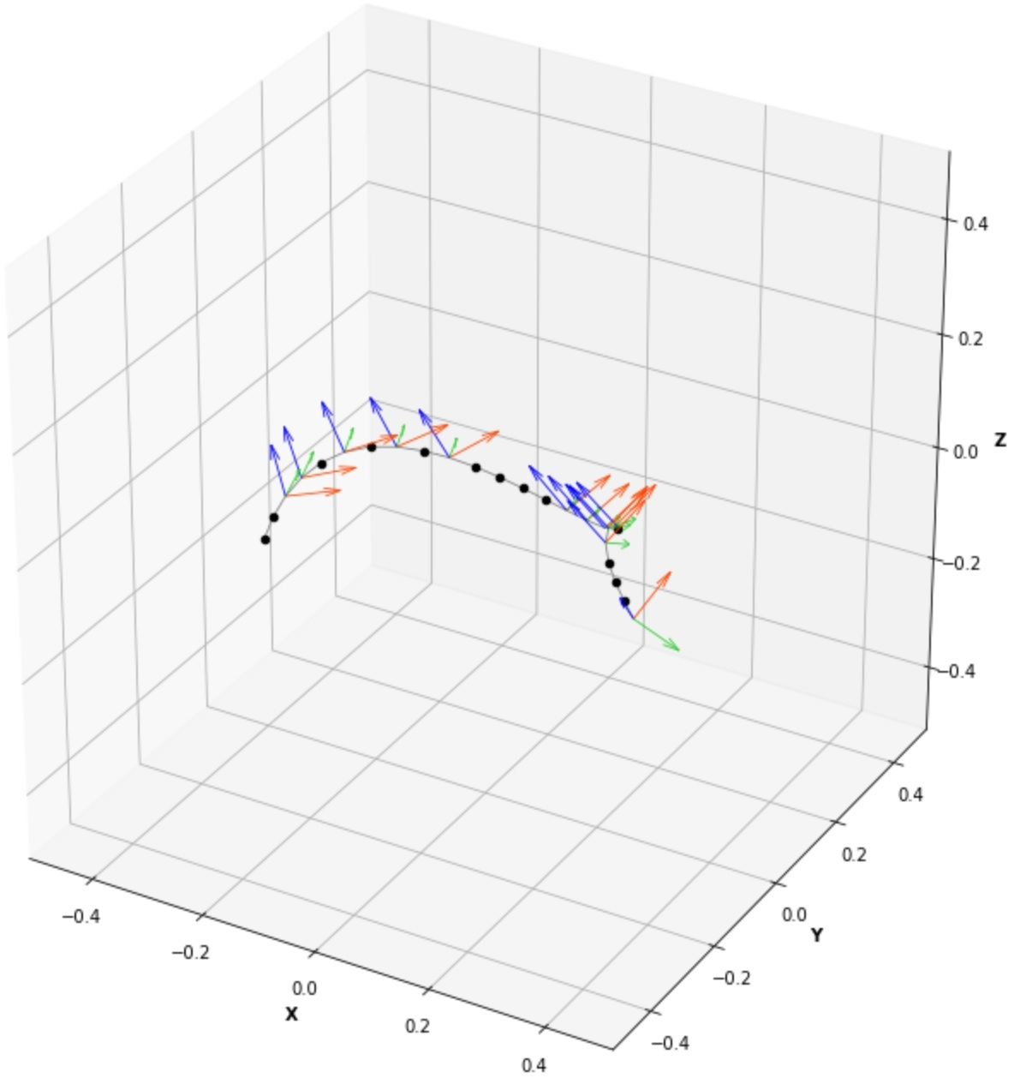
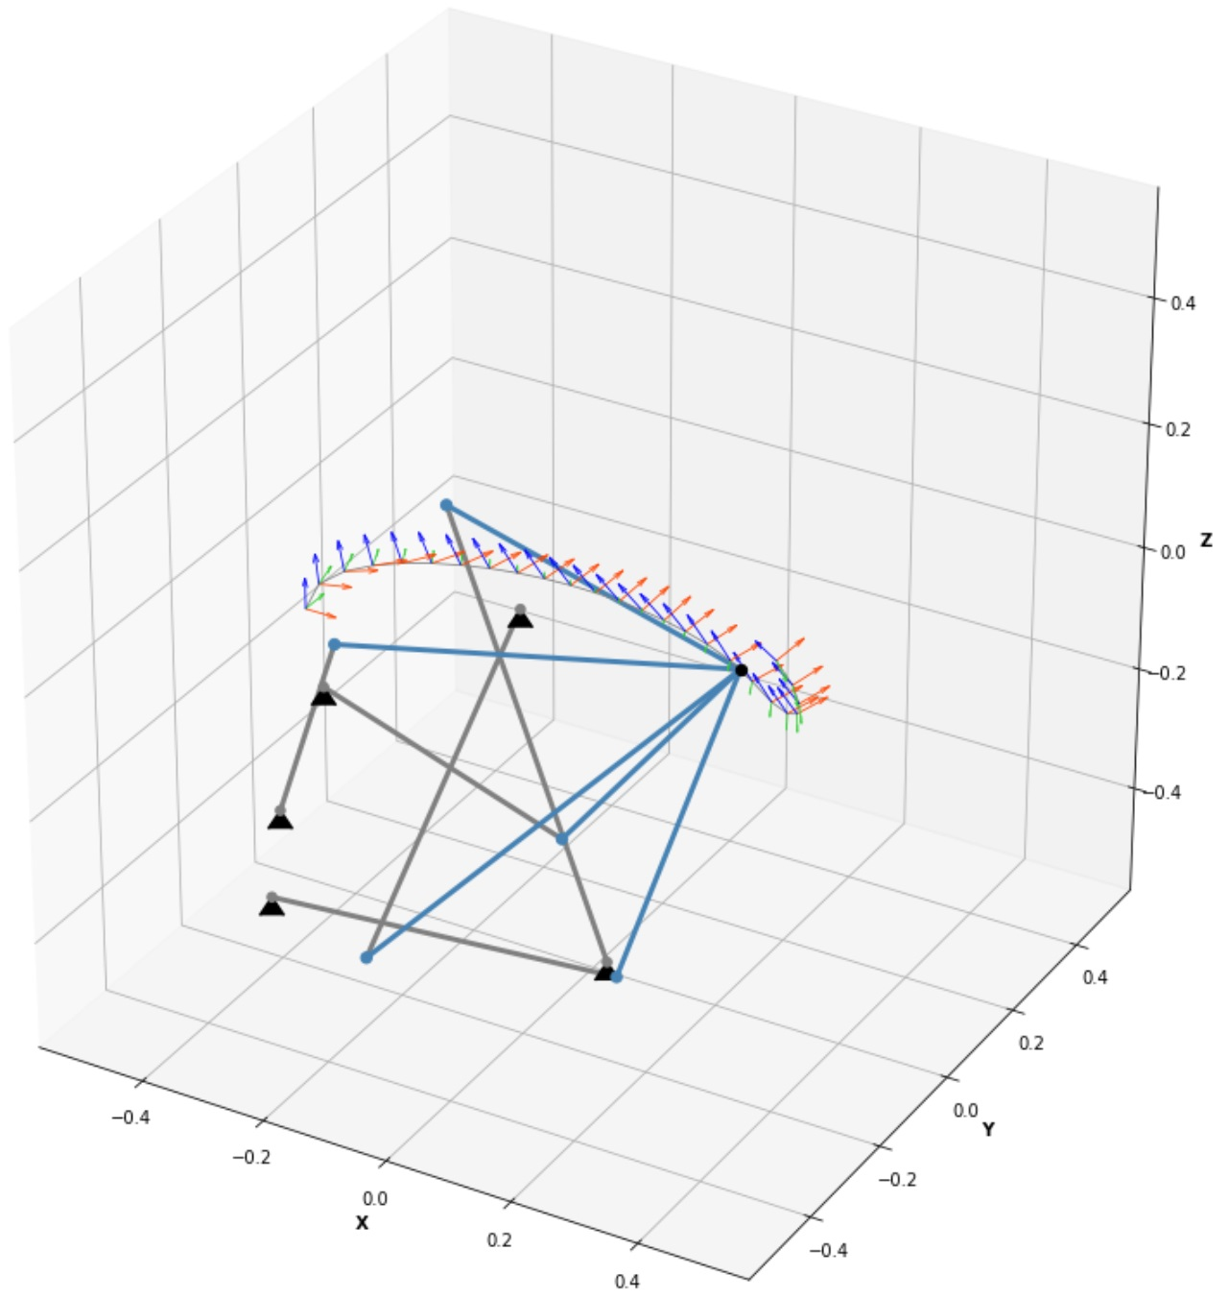
Sample Problem

Slide 26
Unified Motion Synthesis
Unified Design of Spatial, Spherical and Planar Mechanisms for the Motion Synthesis Problem

Slide 27
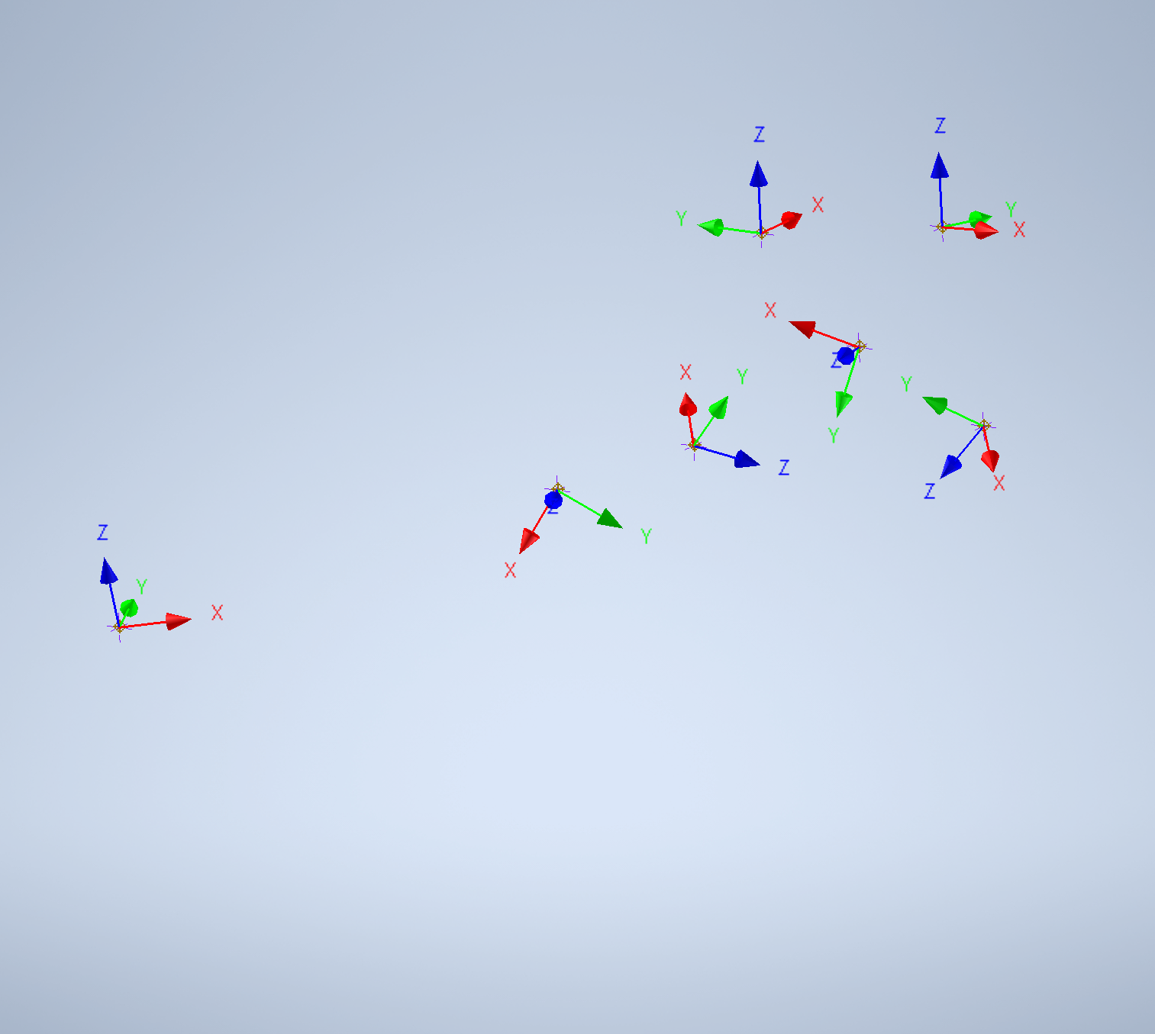
Motion Synthesis Problem
Input- Spatial Poses
Output- Synthesized Mechanism

Slide 28
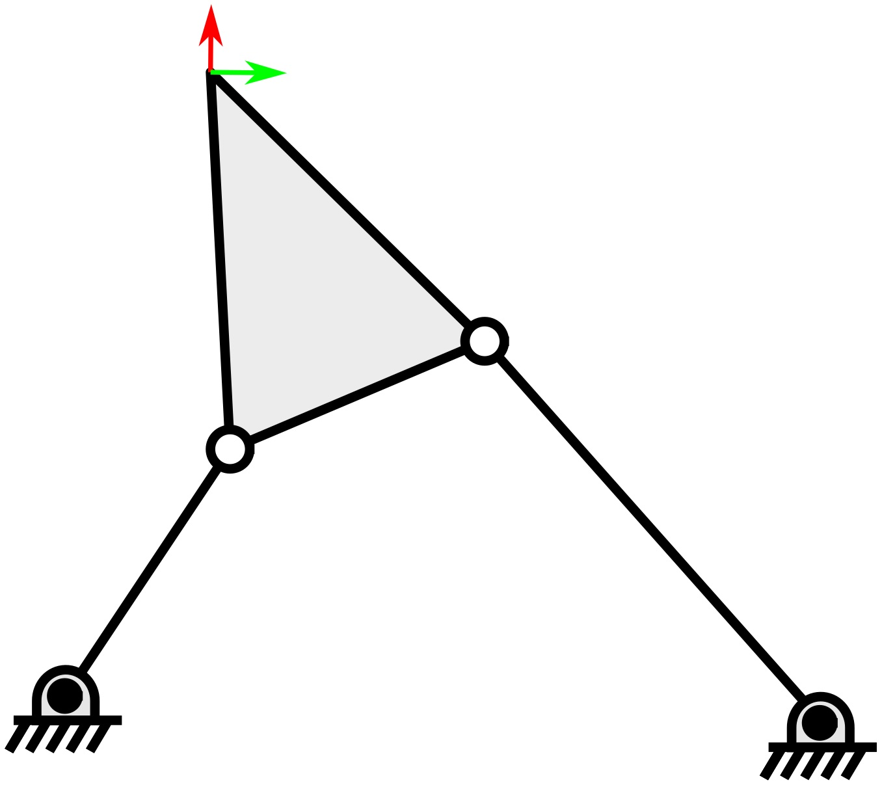
Spatial, Spherical and Planar Mechanisms
Three Family of mechanisms for which motion synthesis algos exist.
Spatial 5-SS Mechanism
Spherical RRRR Mechanism
Planar RRRR Mechanism

Slide 29
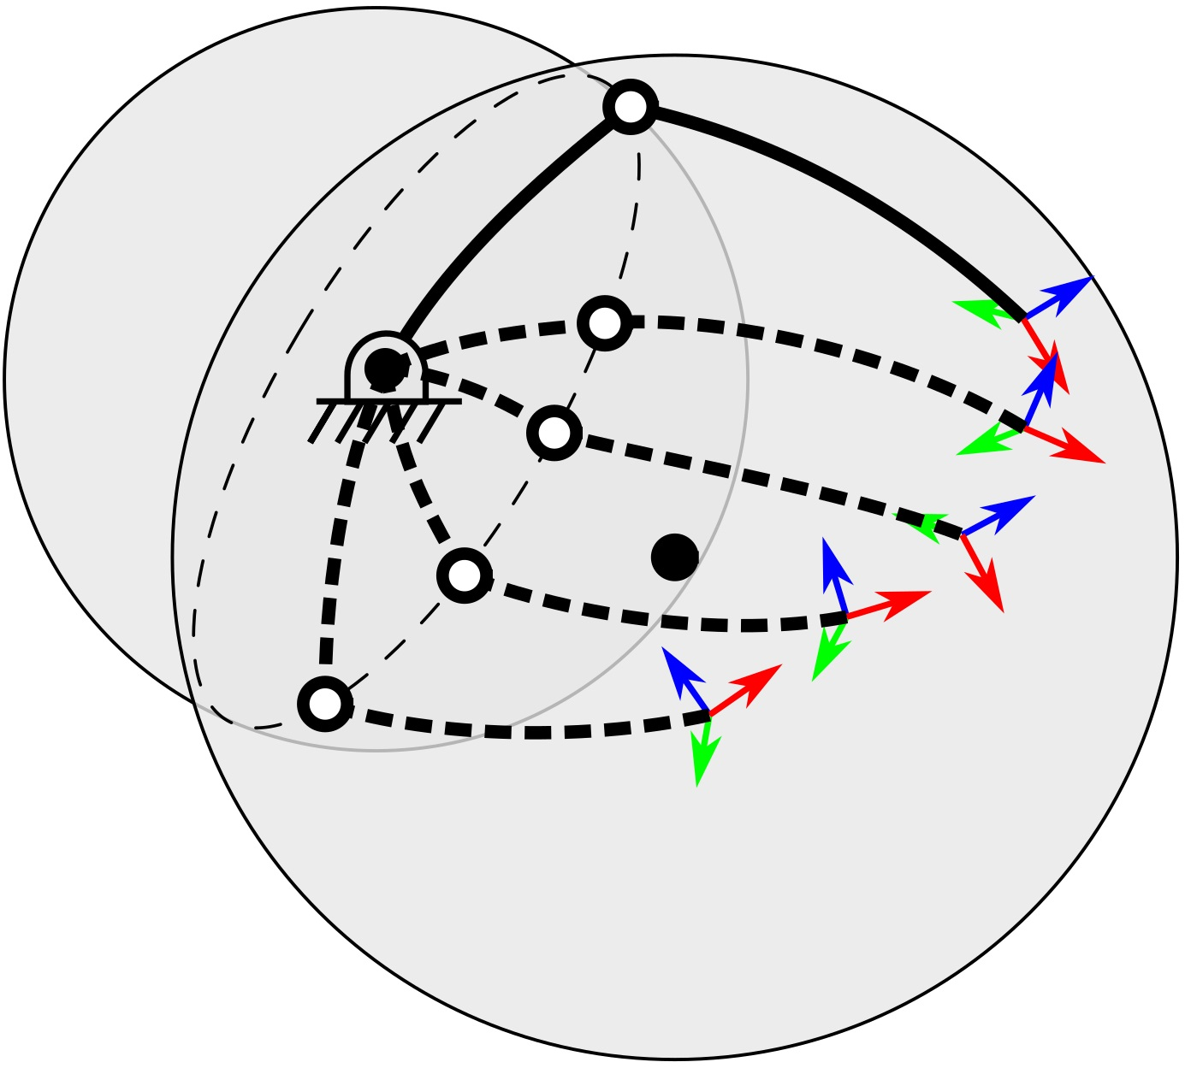
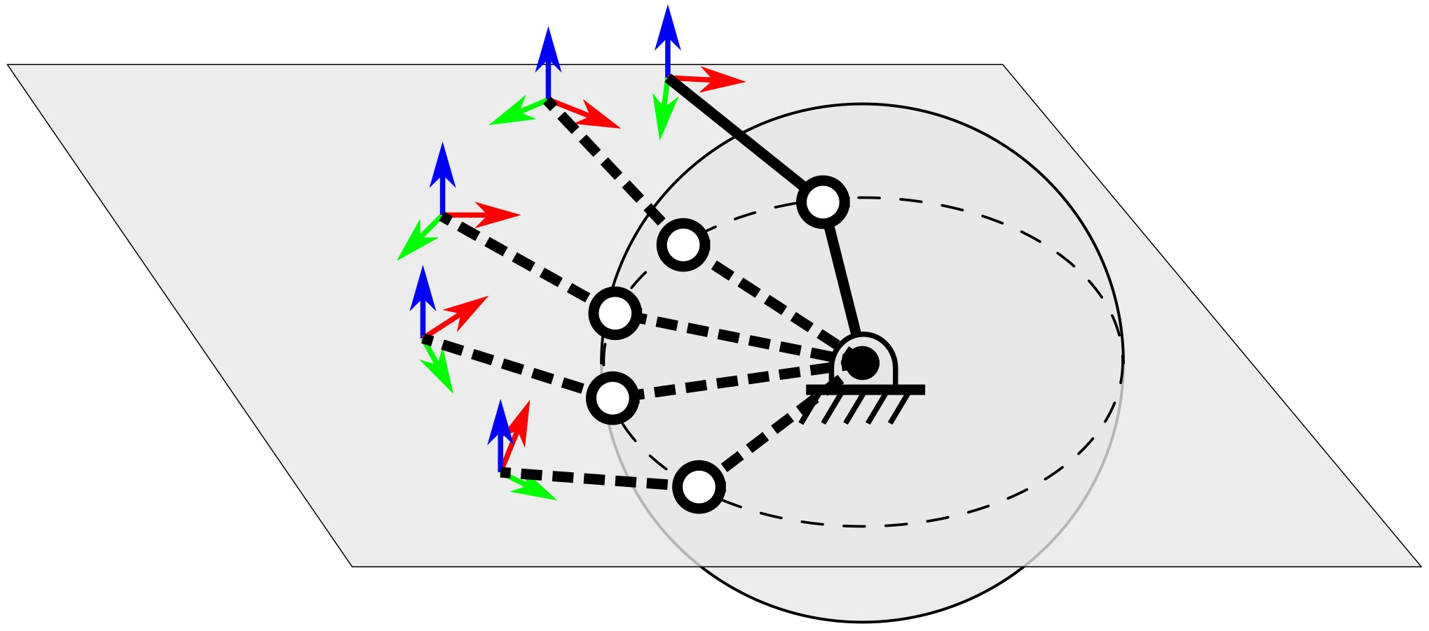
Motivation
A unified algorithm which can generate spatial, spherical or planar mechanisms doesn’t exist.
Unify spatial SS/PS dyad and RR dyad synthesis.
Express RR dyad as a sphere-plane or sphere-sphere intersection.

Slide 30
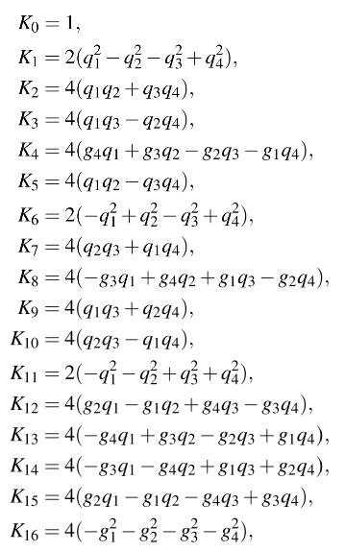
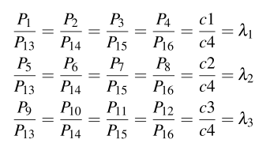
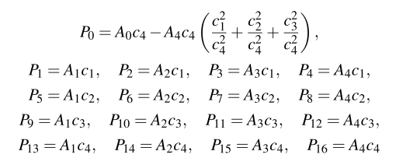
Existing Spatial SS/PS dyad Solver
1. Kinematic Mapping based Geometric constraints
2. Bilinear constraints
3. Dyadic Parameters

Slide 31
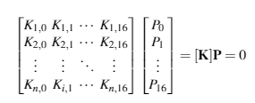
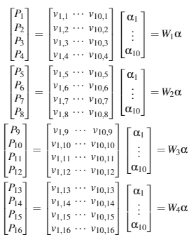
Existing Spatial SS/PS dyad Solver
1. Impose Geometric constraints
2. Impose Bilinear constraints

Slide 32
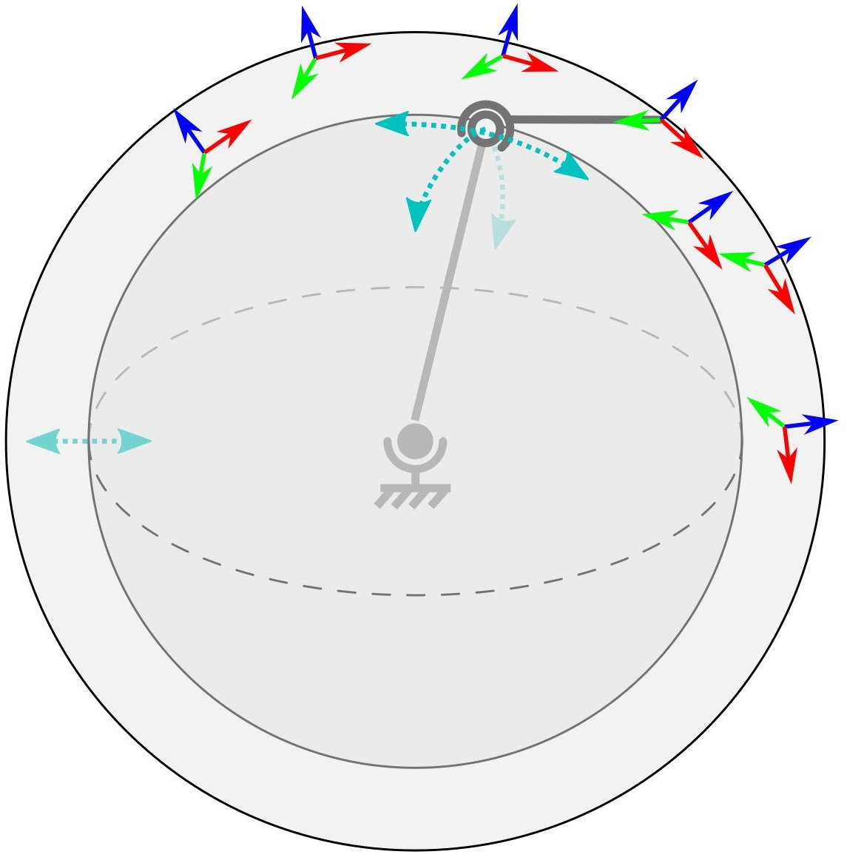
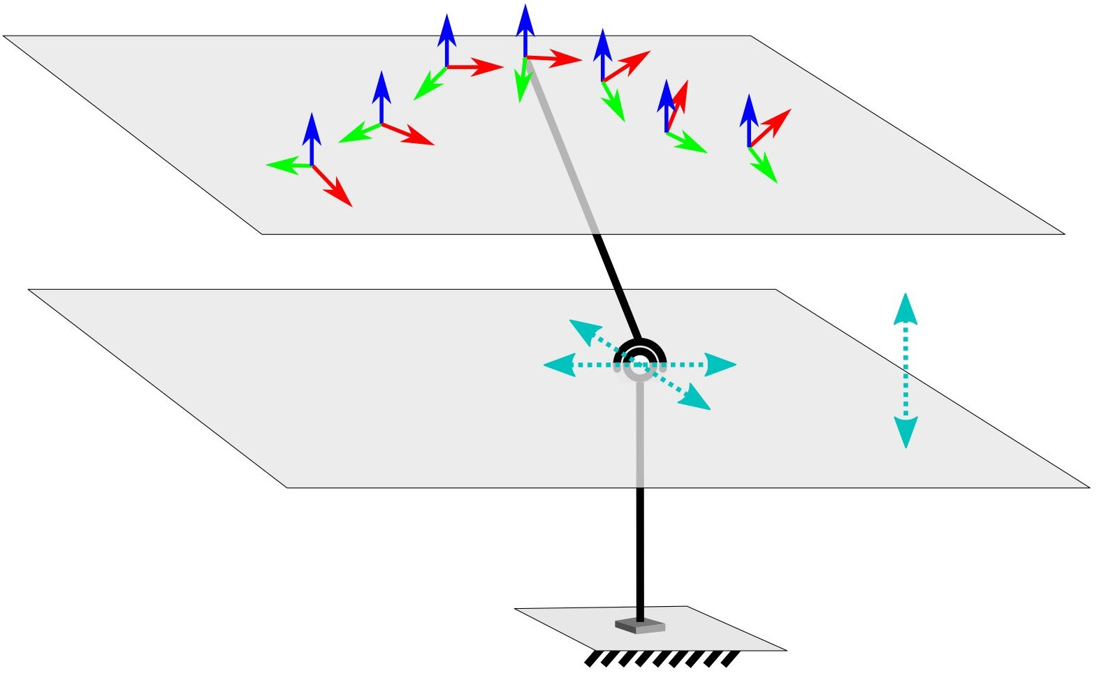
Seven Poses on a Sphere/Plane
The approach is not able to generate solution dyads when spatial poses lie on a sphere or a plane.
There exist 3-$∞$ SS/PS solutions
Bilinear constraints are rank-reduced

Slide 33
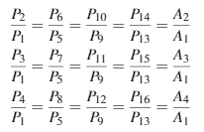
Seven Poses on a Sphere/Plane
Calculate the characteristic-plane or –sphere using zero length coupler dyad i.e. c1,c2,c3=0
Singular vector denotes $α$ and FP coordinates can be calculated.
Four singular vectors of [Z] define the 4D null-space of $α$. It can be back-substituted to find 3-$∞$dyad solution space.

Slide 34
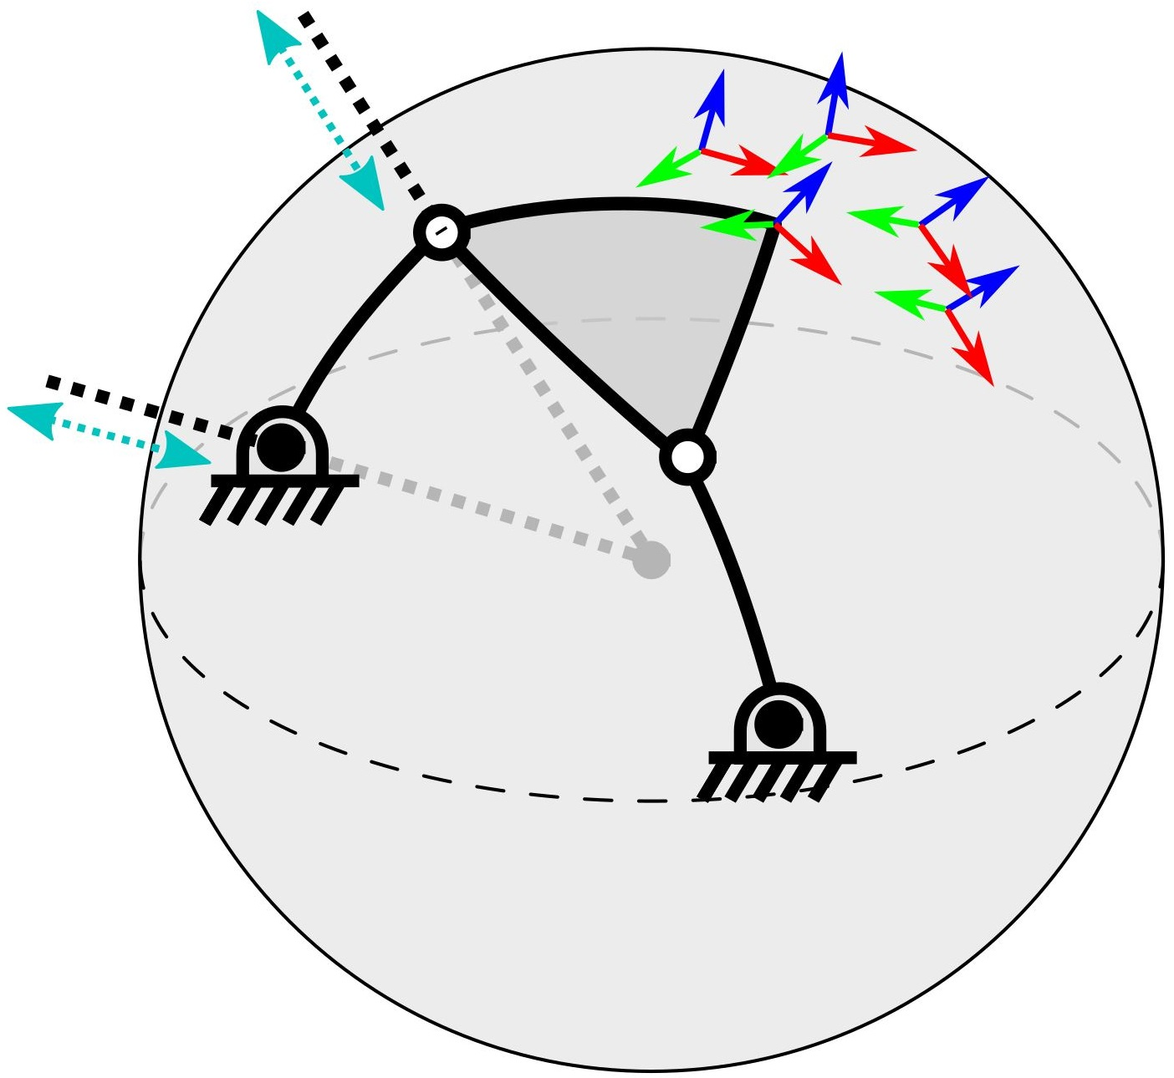
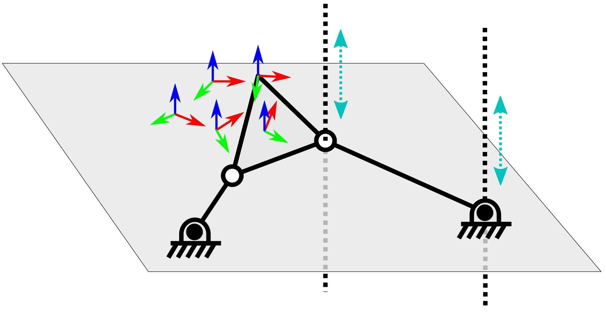
Five Poses on a Sphere/ Plane
First, we check if a characteristic-sphere or -plane exists. If not, only SS dyads exist.
There exist an additional 2-$∞$ SS dyads whose intersection with characteristic sphere/plane constraint represent valid RR dyads.
1-$∞$ spherical constraint isolated by imposing $λ_{3}$ =1, finding $λ_{1},λ_{2}$ and finding 2D nullspace of [W1]
Unique dyad calculated from 1-$∞$ spherical constraints by random sampling.
FP and MP on characteristic primitive can be calculated

Slide 35
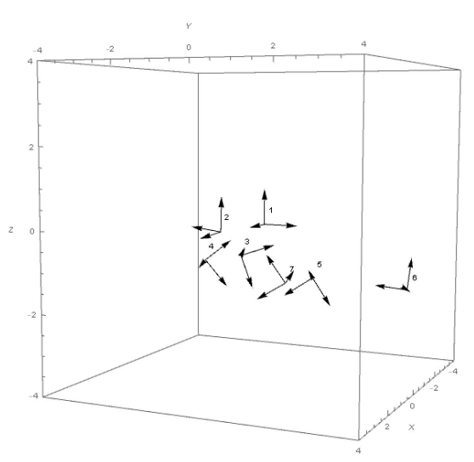
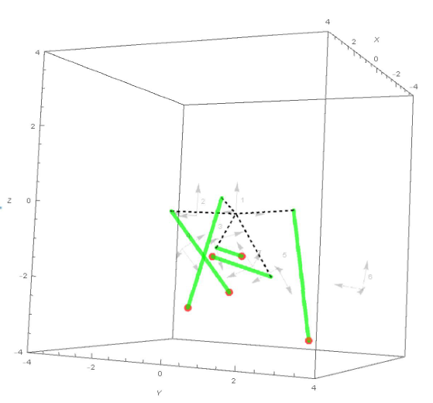
Synthesis of spatial SS dyads

Slide 36
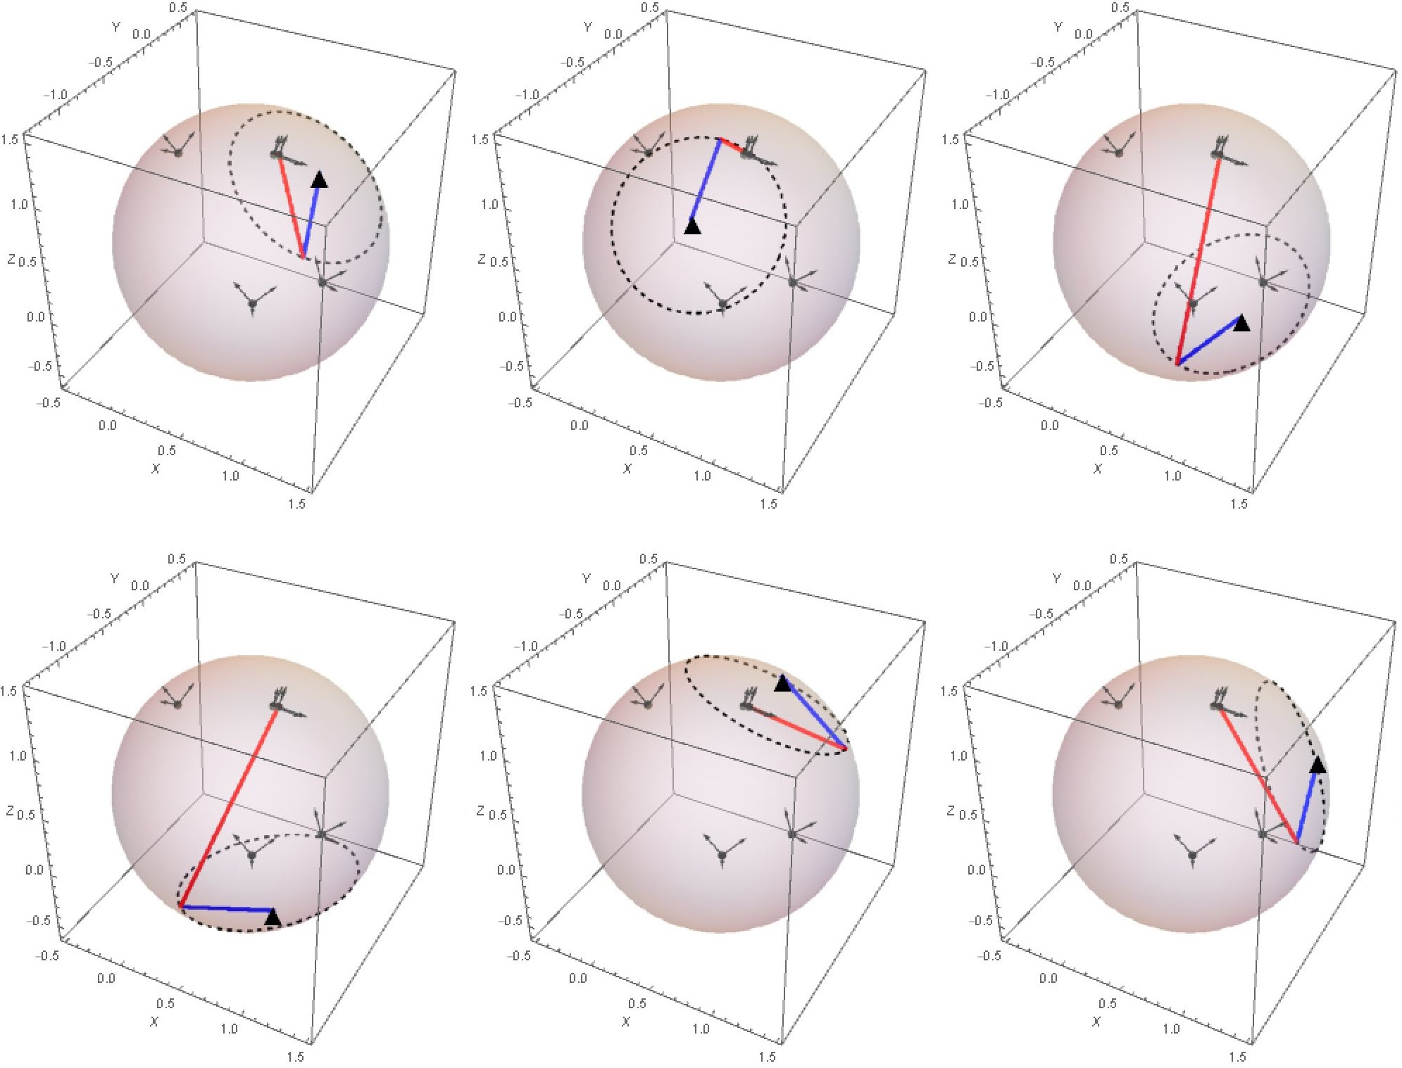
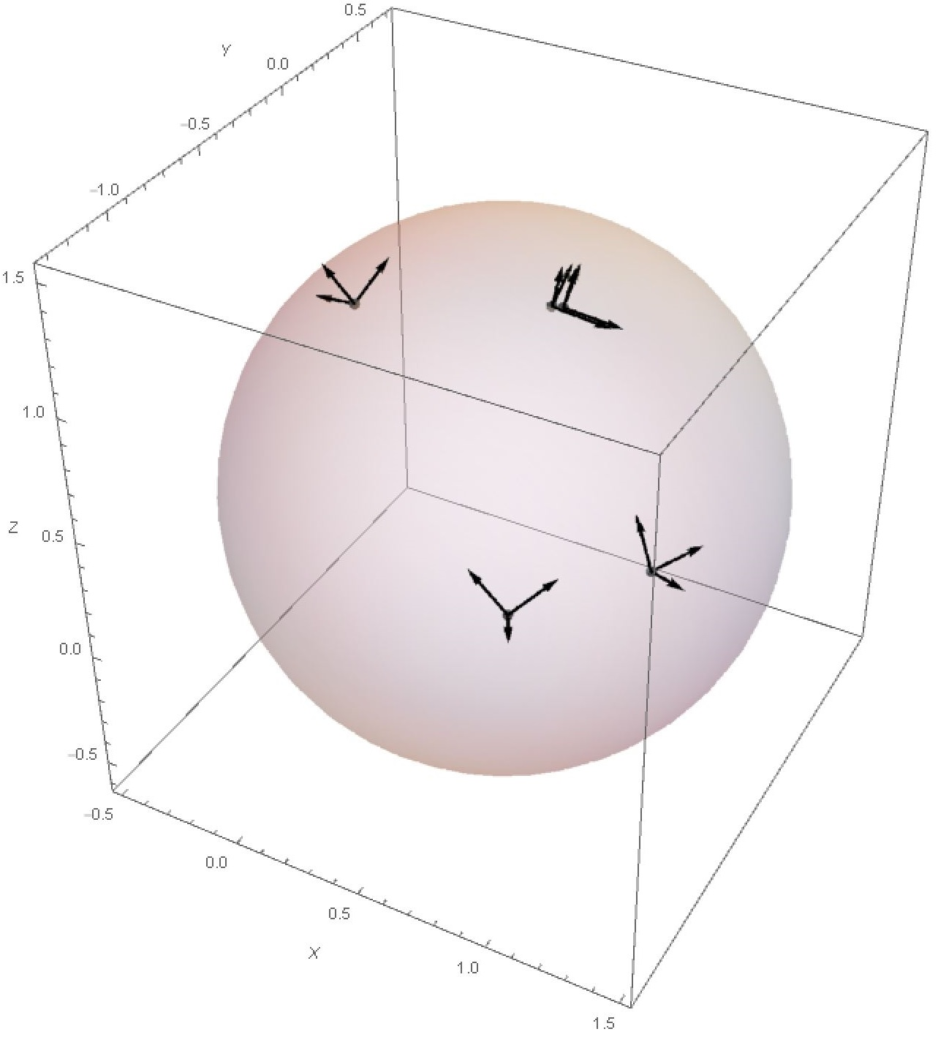
Synthesis of spherical RR dyads

Slide 37
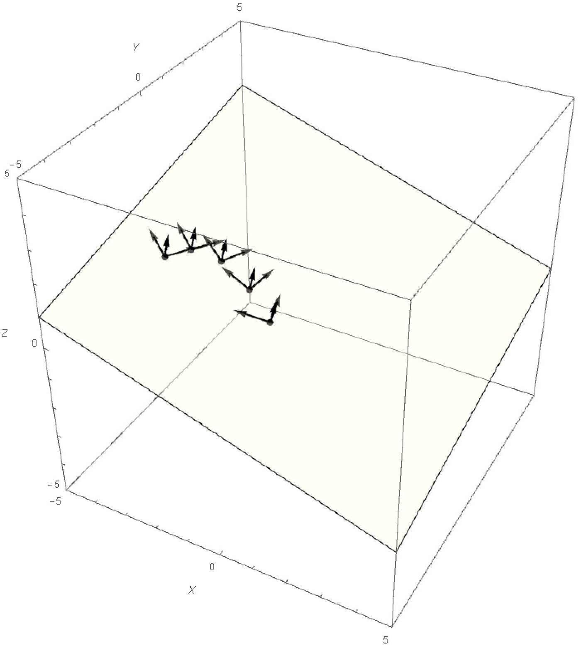
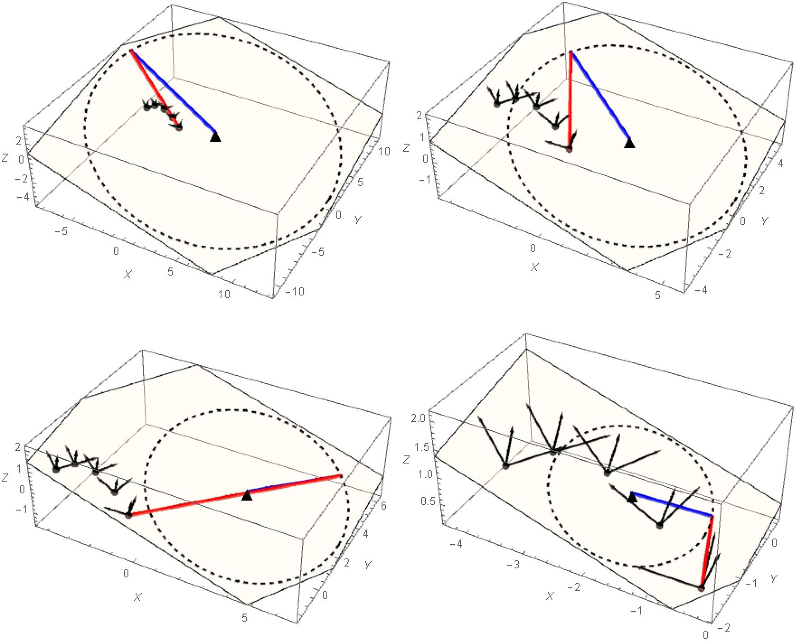
Synthesis of planar RR dyads

Slide 38
Planar Alt-Burmester Synthesis
A Motion Synthesis Approach to Solving Alt-Burmester Problems by Exploiting Fourier Descriptor Relationship Between Path and Orientation Data

Slide 39
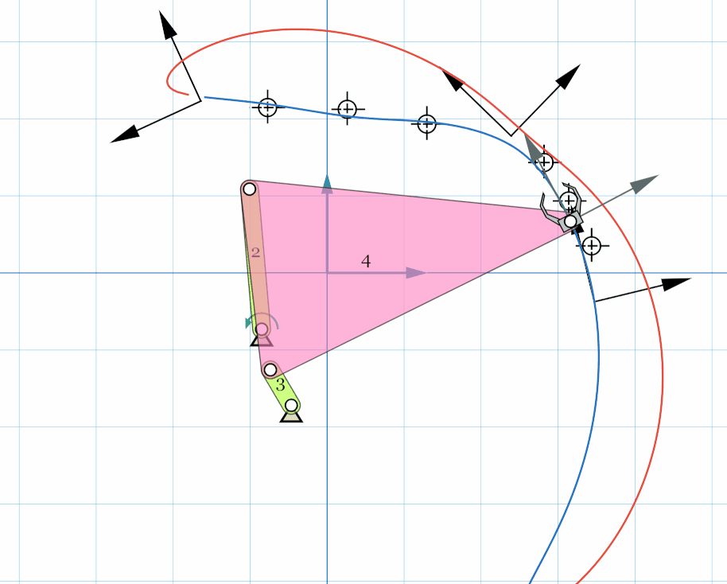
Planar Alt-Burmester Problem
Path Synthesis
Motion Synthesis
Alt-Burmester Synthesis
Only Poses
Only Path Points
Poses + Path Points

Slide 40
Algorithm
Add missing orientations to path points and convert the problem into a pure motion synthesis problem
Carry out simultaneous Type and Dimensional synthesis using efficient motion synthesis algorithm

Slide 41
Task curve computation
Task Curve equation:
$T_{k}$: Task curve Fourier descriptors
$t$: Prescribed time information
$z\left(t\right)\text{:}$ Point coordinates in complex form
$k\text{:}$ Frequency index
$ω_{0}\text{:}$ Angular velocity of crank
$[0,t_{max}]\text{:}$ time interval over which task curve is defined
$T_{k}$and $t_{max}$are calculated by minimizing the fitting error
Notes:
A task curve is defined as a Fourier series as shown in the equation. It is characterized by its FDs Tk and the time interval tmax.
Tk and tmax are calculated by minimizing the fitting error function which represents the quality of fit of task curve to path points.
Once we have the task curve, we can move to the next step.

Slide 42
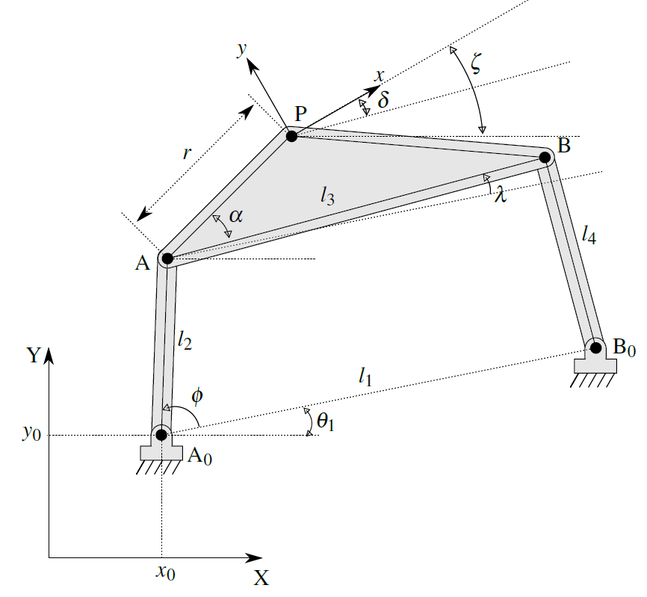
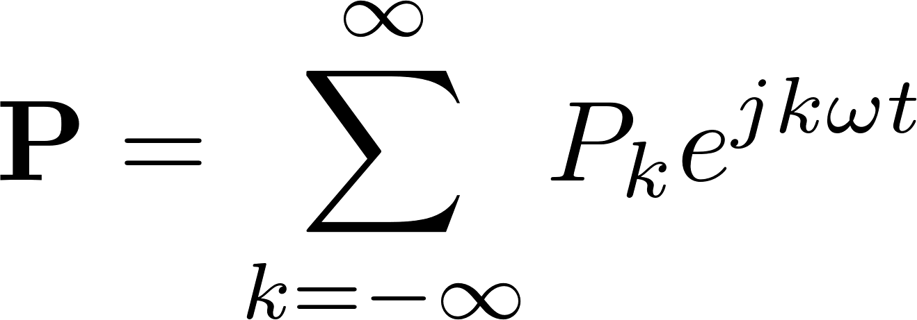
Calculating unknown orientations
Coupler angle $λ$
Coupler point $P$
Notes:
To find the missing orientations, we need a relationship between the task curve FDs and coupler point orientation since they are dependent on each other for a four-bar mechanism. To develop this relationship, we first represent the Coupler angle as a Fourier series. The Coupler angle FDs are directly related to the Coupler point FD using the following relationships which can be derived using the vector sum equation.

Slide 43
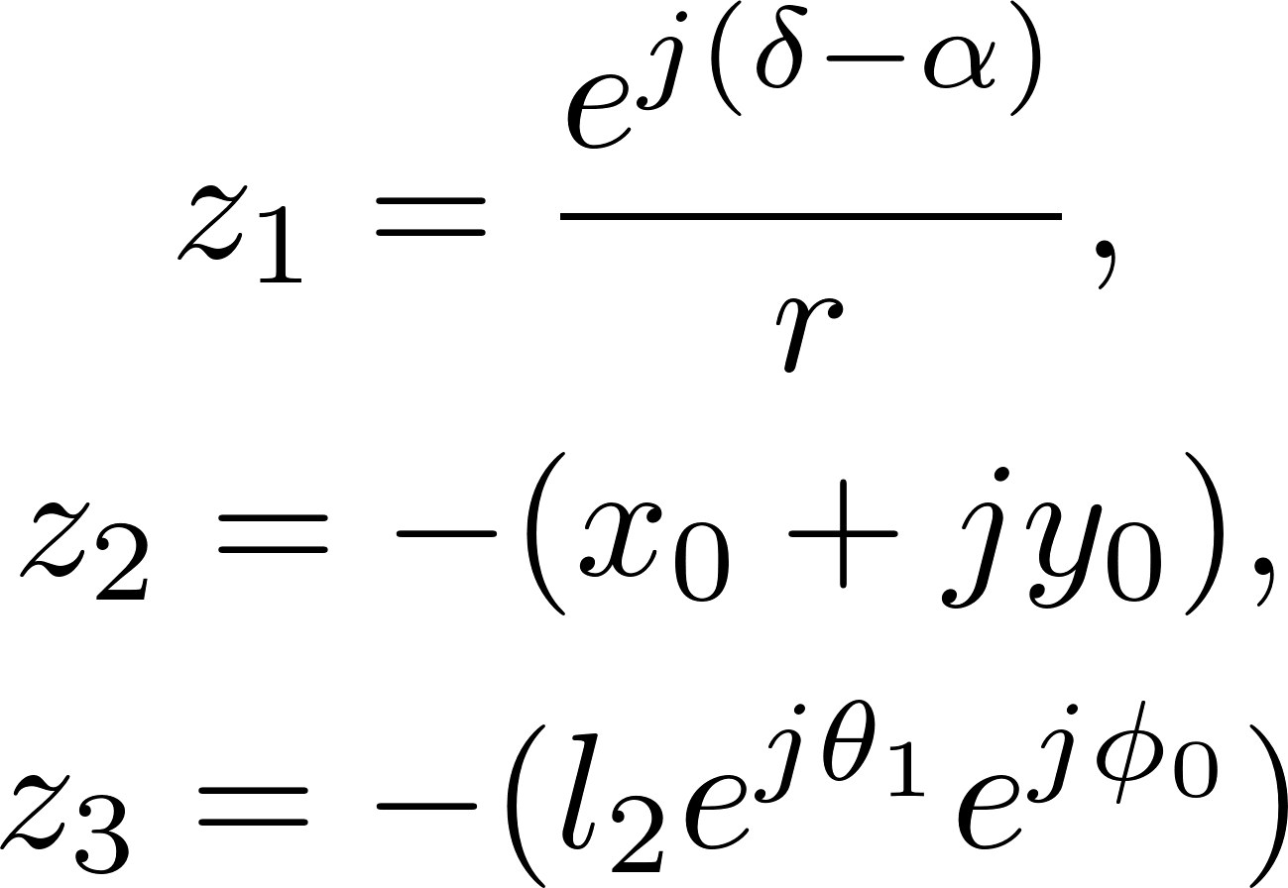
Calculating unknown orientations
Coupler orientation
Closed-form Fourier relationship between orientations and path descriptors
Notes:
The coupler orientation is the sum of fixed link angle, coupler ang and the angle at which moving frame is fixed. This equation can be used to relate the Coupler angle FDs to coupler orientation FDs. Now, an explicit relationship can be found out by eliminating the coupler angle FDs from the path and orientation equations and simplifying it algebraically. The equation is dependent on three constants z1,z2 and z3 which are called Mixed synthesis parameters or MSP.

Slide 44
Calculating unknown orientations
System of equation between orientation and path FDs
Known $m$-Pose orientations are used to calculate MSP.
When $m>3$, least square solution to MSP
When $m=3$, unique solution to MSP
Notes:
The relationship can be written as a system of equation to find the unknown MSPs using known pose orientations. >,=,< 3 poses lead to different cases.

Slide 45
Calculating unknown orientations
When $m<3$, the system of equations is under-constrained.
Additional constraints are called mixed constraints (MIC) which are
Specify coupler parameters i.e.
Specify actuating fixed pivot i.e.
Specify scale of input link, orientation of fixed pivot line, and initial angle i.e.
Calculated MSP are used to generate missing orientations.
Notes:
Once we have calculated the MSPs based on specified orientation and task path, we can generate the missing orientations using the same relationship. This results in an m+n pose problem.

Slide 46
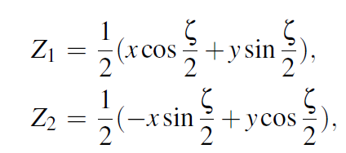
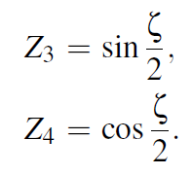
Algebraic fitting based motion synthesis
Map poses to quaternion space
Calculate coefficients of G-manifold coefficient matrix
Notes:
Since the problem is now of Motion synthesis, we use algebraic fitting based algorithm. It enables simultaneous type and dimensional synthesis and efficient computation.
The G-manifold can represent dyadic constraints for dyads involving both R or P joints.

Slide 47
Algebraic fitting based motion synthesis
System of equation $[A]q=0$ solved using SVD.
Additional C-manifold constraint equations.
When $m+n<5$, additional motion constraints (MOC) are required which are
Fixed pivot location using line or point constraints.
Moving pivot location using line or point constraints.
Type and dimensional synthesis of up to six unique four-bar mechanism.
Notes:
$[A]$ is the G-manifold coefficient matrix. $q$ is the column vector of homogenous coefficients.
Finally, we can generate the four- bar mechanism. Let us combine all the pieces and see how the algorithm deals with generalized m-pose n-path mixed synthesis problem.

Slide 48
Unified m-pose n-path synthesis algorithm
MIC- Mixed constraint
MOC- Motion constraint
FD- Fully defined
X- Trivial/ under defined

Slide 49
Example 1: Reverse Engineering a Mechanism
Five pose, seven path-points
Notes:
The average path error measured by calculating the deviation of input points from final path using the Euclidean distance is 0.0694 units for the displayed configuration. The maximum angular deviation among all the given poses is for the pose 3 as 0.0736 rad.(4 degree)

Slide 50
Example 2: Mixed synthesis with fully-constrained MSP computation
Three pose, five path-points mixed synthesis
Eight pose motion synthesis
Notes:
Average path error is 0.0226 units while the maximum angular deviation for poses is 0.0106 rad (.6 degree) for second pose.

Slide 51
Example 3:Under-constrained mixed synthesis
Two pose, four path-points mixed synthesis using additional mixed constraint
Three pose, one path-points mixed synthesis using additional motion constraint

Slide 52
Planar Path Synthesis
An Optimal Parametrization Scheme for Path Generation Using Fourier Descriptors for Four-Bar Mechanism Synthesis

Slide 53
Path Synthesis Problem
Existing algorithm for path synthesis is efficient but works in limited conditions.
The proposed improvements enhances the quality of results found by the path synthesis algorithm.

Slide 54
Effect of assuming uniform time parametrization
Poor result with existing algorithm
Good result with proposed algorithm

Slide 55
Path Synthesis using FD: Review
Task curve
Mechanism parameters
Relationship with Path FD
$T_{k}$: Task curve Fourier descriptors
$t$: Prescribed time information
$z\left(t\right)\text{:}$ Point coordinates in complex form
$k\text{:}$ Frequency index
$ω_{0}\text{:}$ Angular velocity of crank
$[0,t_{max}]\text{:}$ time interval over which
task curve is defined
4D minimization problem
Objective function

Slide 56
Family of parametrizations
Uniform time parametrization considers only task curves which have uniform speed which drastically reduce the possible task curves.
Non-uniform parametrization used to generate richer space of task curves.
A family of chord-length based time parameterizations have been proposed where $t$ is defined as
$t_{k}$: time parameter associated with the $k^{th}$ path point
$z_{i}$: coordinates of $i^{th}$ path point
$α$: parametrization control variable
$$z_{1}$$
$$z_{7}$$
$$z_{2}$$
$$z_{6}$$
$$z_{5}$$
$$z_{3}$$
$$z_{4}$$

Slide 57
Optimal Parametrization
Cost of selected parametrization
The two dimensional search space is $\{α,t_{max}\}$
$C_{t}$: Total cost
$C_{f}$: Fitting cost
$C_{h}$: Harmonic cost
$C_{s}$: Speed cost
Notes:
A cost metric is proposed to estimate the quality of a parametrization. It has three distinct parts. Minimizing the cost function yields optimal alpha and tmax to be used.

Slide 58
Optimal Parametrization: Fitting cost
Normalized fitting cost for a task curve
Notes:
First cost term represents normalized fitting cost for the task curve. P2 Norm of the error for each path-point divided by number of points. Ensures accurate task curve.

Slide 59
Optimal Parametrization: Harmonic cost
Harmonic analysis of four-bar coupler curves have the magnitude of higher order harmonics to be negligible.
Normalized weighted harmonic magnitude for a task curve
Notes:
Second cost term represents harmonic cost. Past studies on Harmonic content of four-bar have shown that the magnitude of higher order harmonic is negledgible. To find task curves which follow this inherent four-bar coupler curve property, a cost function is designed. It penalizes large magnitudes on higher order harmonics.

Slide 60
Optimal Parametrization: Speed cost
Speed of coupler point is
Speed cost can be defined using quadratic penalty function as
$S_{r}$: Maximum to minimum task curve speed ratio
$S_{r,min}$: Minimum speed ratio bound specified by user
$S_{r,max}$: Maximum speed ratio bound specified by user
Notes:
Large coupler speed changes can lead to large induced forces on the links. This could compromise their rigidity and render the kinematic analysis useless.
In contrast, a uniform speed motion of the coupler can also be undesirable in instances like a quick-return mechanism.
Thus, enforcing a speed based criteria over the task curve gives users more control in design.
We use Speed ratio based penalty function to enforce the speed criteria.

Slide 61
Example
Task curve speed
$C_{f}$=0.3509, $I$=0.0228
$C_{f}$=0.0591, $I$=0.0067
$S_{r}$<2
$C_{f}$=0.1813, $I$=0.0444

Slide 62
Unified Simulation
Using a Point-Line-Plane Representation for Unified Simulation of Planar and Spherical Mechanisms.

Slide 63
Simulation
Visualization capability of a design tool is dependent on its simulation solver.
PMKS
Synthetica
GIM
VEMECS
SAM
Linkage
No unified planar and spherical n-bar kinematic simulators

Slide 64
Issues with Commercial Packages
Creation of feature-based assembly and initializing constraints on these systems is a nontrivial task.
Changing the type of joints or the number of links for a mechanism is also more complex.
For detail design
Slower than purely kinematic simulators

Slide 65
Planar and Spherical geometric constraints
Spherical mechanism constraints
Planar mechanism constraints

Slide 66
Iterative solver
Simulation Algorithm
System of constraint equations
Newton-Rhapson iteration
q: State vector
[J(q)]: Jacobian matrix
$Φ$(q): Residual vector

Slide 67
Examples
Watt's steam engine mechanism
Spherical Watt I six-bar mechanism

Slide 68
Examples
Planar Stephenson II six-bar linkage
Spherical RRPR four-bar linkage
Spatial 5-SS platform linkage

Slide 69
Summary

Slide 70
Dissertation Contributions
Alt-Burmester Synthesis
- ML approach for spatial mechanisms
- Analytical approach for planar mechanisms
Kinematic Analysis
- Numerical approach to simulate planar, spherical and spatial mechanisms
Motion Synthesis
- Analytical approach for unified synthesis of planar, spherical, and spatial mechanisms
Path Synthesis
- ML approach for spatial mechanisms
- Analytical approach for planar mechanisms

Slide 71
Thank You

